Slide 1


PERSONALIZED RECOMENDATION SYSYEM
ONLINE COURSE RECOMMENDATION SYSTEM WITH MACHINE LEARNING
ABHISHEK GOSWAMI
06/29/2023

Slide 2

OUTLINE
01
INTRODUCTION AND BACKGROUND
02
EXPLORATORY DATA ANALYSIS
03
CONTENT-BASED RECOMMENDATION. USING UNSUPERVISED LEARNING
04
COLLABORATIVE-FILTERING BASED RECOMMENDATION USING SUPERVISED LEARNING
05
CONCLUSION
06
APPENDIX

Slide 3





INTRODUCTION
Importance of Recommendation Engines:
Overcoming information overload for users.
Increasing user engagement and satisfaction.
Enabling personalized learning experiences.
Project Background and Context:
The project focuses on analyzing two key datasets: course ratings
Course Data: Contains course IDs, titles, and genre features
Ratings Data: User-course ID pairs and corresponding ratings
Hypothesis:
By implementing recommendation techniques, we can improve course discovery and user satisfaction.
Techniques like content-based, similarity-based, clustering-based, and collaborative filtering approaches will be used.
Objective:
Provide an overview of recommendation engines and their applications
Showcase analysis and results of different recommendation techniques
Highlight the effectiveness of personalized course recommendations
Notes:
Introduction:
Recommendation engines have become an integral part of modern online platforms, enhancing user experience by providing personalized suggestions tailored to individual preferences and interests. In this presentation, we will explore the concept of recommendation engines and their importance in improving user engagement and satisfaction.
Project Background and Context:
The project focuses on building a recommendation engine for a Coursera lab, which involves analyzing two key datasets: course data and ratings data.
The course data consists of various course IDs, along with their corresponding titles and genre features, such as Python, cloud computing, etc. Each genre feature is represented by a binary value (1 if the course belongs to that genre, 0 otherwise).
The ratings data contains user-course ID pairs and the corresponding ratings given by users. This data helps in understanding user preferences and evaluating the performance of the recommendation engine.
Why Recommendation Engines are Necessary:
Information overload: With an increasing amount of content available, users often face difficulties in finding relevant and interesting courses. Recommendation engines address this challenge by filtering and presenting personalized recommendations, saving users time and effort.
User engagement: By providing tailored suggestions, recommendation engines enhance user engagement, increasing the likelihood of users exploring new courses and staying active on the platform.
Personalized learning: Every learner has unique preferences and interests. Recommendation engines enable personalized learning experiences, ensuring that users receive course recommendations aligned with their specific needs and goals.
Problems to Address:
Course Discovery: Users struggle to discover courses that align with their interests due to the vast amount of available content. A recommendation engine can address this problem by offering personalized course suggestions based on user preferences and historical data.
Information Overload: The abundance of courses makes it challenging for users to narrow down their choices. A well-designed recommendation engine can filter and prioritize course recommendations, presenting users with a curated selection that matches their interests.
Hypothesis:
We hypothesize that by implementing various recommendation techniques, such as content-based, similarity-based, clustering-based, and collaborative filtering approaches, we can significantly improve the course discovery process and enhance user satisfaction.
Furthermore, incorporating techniques like word2vec and bag-of-words can improve the accuracy and relevance of course recommendations by capturing semantic relationships and textual features.
By the end of this presentation, we aim to provide a comprehensive understanding of recommendation engines and their applications in the context of a Coursera lab. We will also showcase our analysis and results, highlighting the effectiveness of different recommendation techniques in delivering personalized course recommendations.

Slide 4
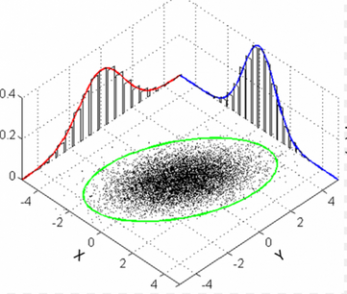
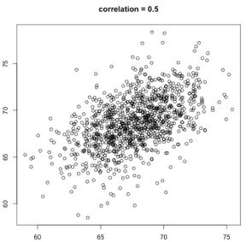


Exploratory Data Analysis

Slide 5
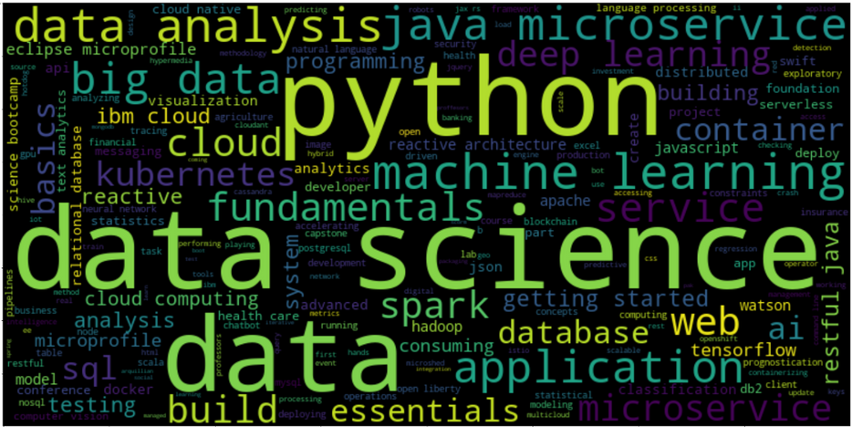
COURSE TITLE WORD CLOUD
Word Cloud
Courses data had a genre and title associated with each course
Overall summary of the all the different course titles shown in the Word Cloud
there are many popular IT related keywords such as python, data science, machine learning, big data, AI, tensor flow, container, cloud, etc.
courses in the dataset are focused on demanding IT skills
Notes:
To summarize the course titles from the course dataframe and get an essence of the type of data present, we can follow these steps:
Extract the course titles from the course dataframe.
Preprocess the titles by removing stopwords using NLTK (Natural Language Toolkit).
Generate a word cloud visualization to gain insights into the most common words in the titles.
As we can see from the ```wordcloud```, there are many popular IT related keywords such as python, data science, machine learning, big data, ai, tensorflow, container, cloud, etc. By looking at these keywords, we should have a general understanding that the courses in the dataset are focused on demanding IT skills.

Slide 6
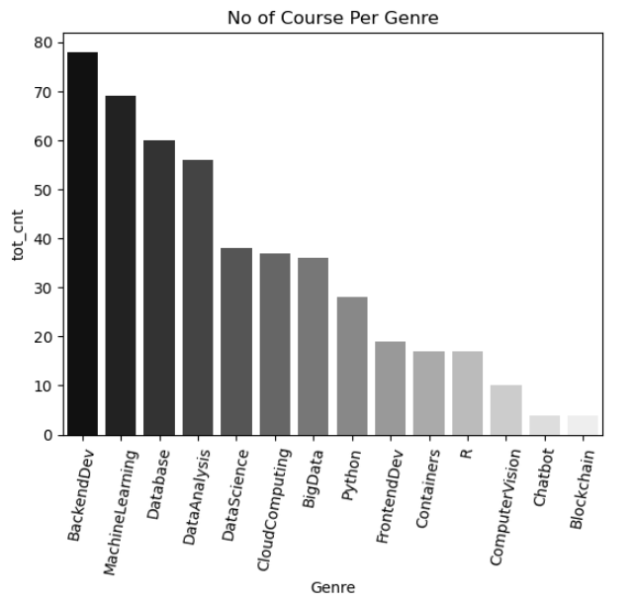
COURSE COUNTS PER GENRE
Genre Distribution
Using Genre from the Course gives us an idea of popular genre
top genre - Backend-Dev, ML, DB, Data Analysis, Data Science
Indicates towards a significant focus on server-side applications, artificial intelligence, data storage, data-driven decision-making, and scientific study of data
Notes:
In this analysis, we aimed to explore the distribution of courses across different genres using their titles. To achieve this, we processed the course data and extracted the genre information. The output of our analysis is a bar plot that showcases the number of courses available in each genre.
The genres represent different areas of study or topics covered by the courses. Here are the key findings from the analysis:
Backend Development: This genre has the highest number of courses, indicating a significant focus on building server-side applications and infrastructure.
Machine Learning: The second most popular genre, suggesting a growing interest in the field of machine learning and artificial intelligence.
Database: With a substantial number of courses, this genre highlights the importance of database management and data storage.
Data Analysis: This genre focuses on courses related to analyzing and interpreting data, indicating the relevance of data-driven decision-making.
Data Science: Although slightly lower in count, this genre indicates a specific emphasis on the scientific study and application of data.

Slide 7
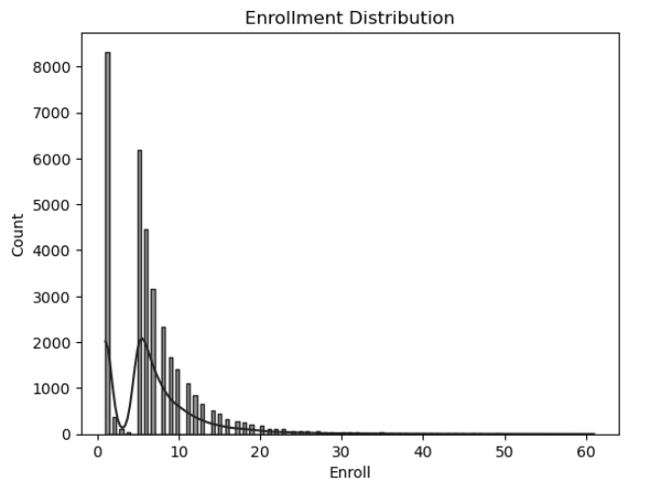
COURSE ENROLLMENT DISTRIBUTION
Enrollment Distribution
Ratings have user, course, and rating information
Telling us about user course interactions
Here we have looked into course enrollment distribution
significant number of users interact with a single course and may not explore other courses
some users are more enthusiastic about learning and tend to engage with multiple courses
users who are highly active and enroll in multiple courses
Notes:
In the ratings data, we have information about users, courses, and the ratings they have given. By analyzing the number of ratings given by each user, we were able to count the total course enrollments of users. We visualized this information using a histogram plot.
The histogram plot showed us the frequency of enrollments. We observed that there is a high frequency of users who have enrolled in only one course. This indicates that a significant number of users interact with a single course and may not explore other courses.
There is a noticeable drop in enrollments from 2 to 5 courses, suggesting that after enrolling in one course, there is a decrease in the likelihood of users enrolling in additional courses up to a certain point.
Interestingly, we observe a peak around 6 to 7 course enrollments, indicating that some users are more enthusiastic about learning and tend to engage with multiple courses.
As the number of course enrollments increases beyond 7, we observe a gradual decrease in frequency until it reaches around 60 enrollments. This suggests that while there are users who are highly active and enroll in multiple courses, the number of such users decreases as the number of course enrollments increases.
Overall, this analysis provides insights into the distribution of course enrollments among users and highlights the varying levels of engagement and learning interests among the user population.

Slide 8
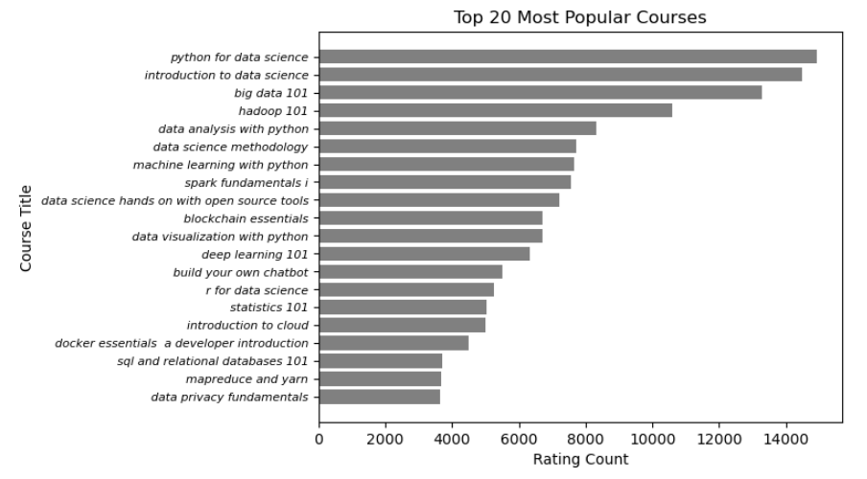
TOP 20 POPULAR COURSES
Popular Courses
63% of the total enrollments comes from these top 20 courses
three most popular courses suggests a strong interest in data science, analytics among the users
technologies and tools like Hadoop, Spark, Docker indicates a demand for learning these technologies for data processing and management
Notes:
The top 20 most popular courses, based on the rating counts, provide valuable insights into the preferences and interests of the users. This information can be tied to the previous slides that showed the enrollment distribution and highlighted the presence of users with varying levels of course interactions.
Some key insights from the visualization of the top 20 most popular courses include:
Python for Data Science, Introduction to Data Science, and Big Data 101 are the three most popular courses, with the highest rating counts. This suggests a strong interest in data science, analytics, and big data technologies among the users.
Courses related to specific technologies and tools like Hadoop, Spark, Docker, and SQL and Relational Databases have a significant presence in the top 20 list. This indicates a demand for learning these technologies for data processing and management.
The inclusion of courses like Data Science Methodology, Data Science Hands-on with Open Source Tools, and Deep Learning 101 highlights the interest in gaining comprehensive knowledge and practical skills in the field of data science and machine learning.
The presence of courses on Blockchain, Data Privacy Fundamentals, and Introduction to Cloud reflects the growing importance of emerging technologies and their impact on various industries.
It is interesting to note that there is a mix of foundational courses such as Statistics 101 and introductory courses for specific technologies like MapReduce and YARN. This suggests a diverse learning approach among the users, with some focusing on building foundational knowledge while others delve into specialized areas.
Overall, the top 20 most popular courses provide valuable insights into the areas of interest and learning preferences of the user base. These insights can be used to tailor course offerings, develop targeted learning programs, and further enhance the educational experience for users.

Slide 9

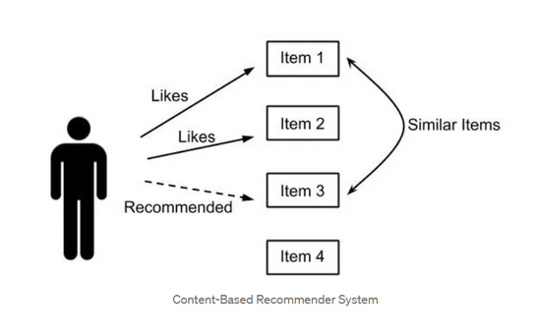
Content-based Recommender System Using Unsupervised Learning

Slide 10

CONTENT-BASED RECOMENDER
Using User Profiles and Course Genres
3 datasets
Course_genre - Course_id, Title, Genre vector *
Profile_genre - Userid, Genre Vector *
Test_user_rating - User_id, course_id, rating
Generate a user profile vector using Profile Genre data for each test user
Identify unseen courses for the user by subtracting enrolled courses from all available courses
Generate unseen courses genre matrix
Perform Dot product of unseen course genre matrix and test user profile vector to get recommendation scores for each unseen course for the user
Utilize a predefined score threshold to identify unseen courses to be recommended to the User
The threshold is selected based on course recommendation requirement **
Unseen Courses having Recommendation scores higher than the threshold are recommended to the user
RECOMENDATION SCORE
RECOMMEND COURSES
RAW DATA
DATA PROCESSING, CLEANING AND FEATURE ENGINEERING
THRESHOLD
Note:
*Genre Vector comprises all available course genres and have values marked only specific to each row
** Threshold score is selected based on requirements, a low threshold means more recommendations and a high would result in very few recommendations
Notes:
In the contest-based recommender system, we leverage user profiles and course genres to provide personalized course recommendations. Let's walk through the key steps involved:
Raw Data:
Course Genre: This dataset contains information about courses, including their IDs, titles, and genre vectors. Each genre vector represents the genres associated with a particular course, where a value of 1 indicates the presence of that genre and 0 indicates its absence.
Profile Genre: This dataset consists of user IDs and corresponding genre vectors. The genre vectors quantify the level of interest a user has in each genre, with higher values indicating stronger interest.
Data Processing, Cleaning, and Feature Engineering:
We start by identifying unique users from the test user rating dataframe and extract the courses they have interacted with. This information forms the "seen courses" data, representing the courses the users have already enrolled in.
Using the course genre data, we compile a list of all available courses. With this information, we can determine the "unseen courses" for each unique user, which are the courses they have not yet interacted with.
Generate Recommendation Score:
To generate recommendation scores, we create a course matrix consisting of genre vectors for the unseen courses. We then perform a dot product between this course matrix and the test user profile vector, resulting in an mx1 vector of recommendation scores. Each score represents the suitability of a course for the specific user based on their genre preferences.
Threshold:
We define a threshold based on the desired recommendation requirements. The threshold serves as a criterion to filter the recommendation scores. If a course's score exceeds the threshold, it is considered a potential recommendation for the user.
Recommended Courses:
Only the courses that have recommendation scores higher than the threshold are recommended to the user. These recommended courses align with the user's interests and preferences, enhancing their learning experience.
By following these steps, we can generate personalized course recommendations by considering user profiles, course genres, and the specified threshold. This approach ensures that users receive recommendations tailored to their individual interests and increases the likelihood of their engagement and satisfaction.

Slide 11
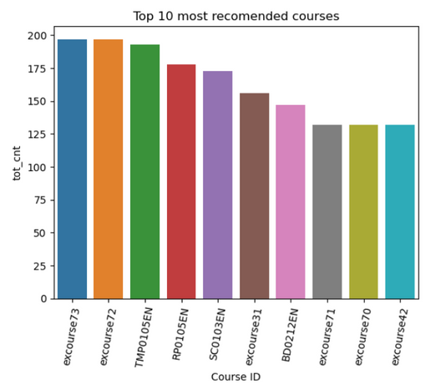
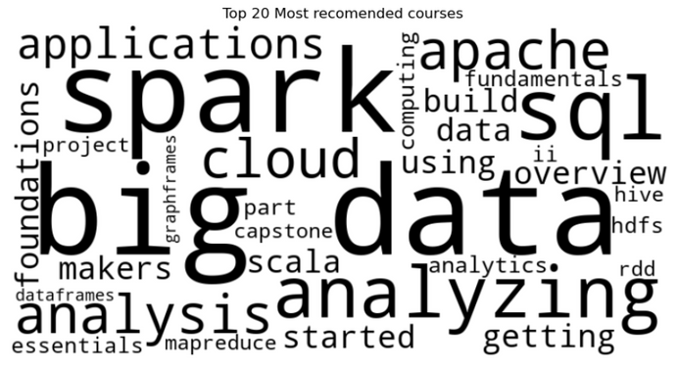
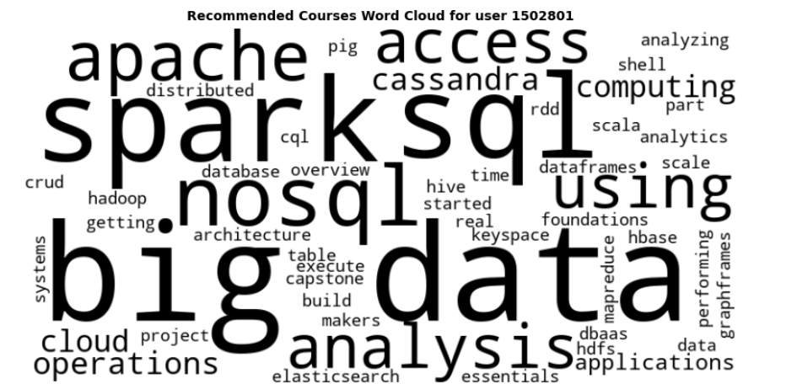
EVALUATION RESULTS OF USER PROFILE-BASED RECOMMENDER SYSTEM
The threshold utilized for this recommendation system is 40
The average recommendation per user is 14 courses
The top 20 recommendations look be specialized for data engineering tools like Spark, apache, big data, scala, MapReduce, etc
Sample recommendations made to user 1502801 in line with overall recomendations
Notes:
For the recommendation system build by me I have used a threshold score of 40 and average recommendation per user is 14 courses,
Also looking into the top 10 most recommended courses I have also created a word cloud that tells use that most of the courses recommended are related to data engineering languages like spark sql bigdata, apache, data analysis, map reduce etc
Also here I have looked into a word cloud for recommendation made to a particular user user id 1502801 to understand the different recommendation made by different algorithms.

Slide 12
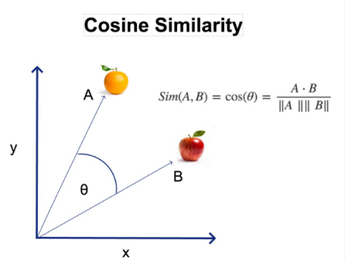
CONTENT-BASED RECOMENDER
Using Course Similarity
Generate a bow feature vector for each course in the course data using the title and description
Using the bow feature vector for the courses creates a similarity matrix utilizing any distance metric algorithm utilized cosine similarity here
As done before identify enrolled and unseen courses for each user
Using the similarity matrix for each user utilize the enrolled courses to find similarity scores for the unseen courses
The similarity score becomes our recommendation score
2 datasets
Course - Course_id, Title, Description
Test_user_rating - User_id, course_id, rating
Utilize a predefined score threshold to identify unseen courses to be recommended to the User
The threshold is selected based on course recommendation requirement **
Unseen Courses having Recommendation scores higher than the threshold are recommended to the user
RECOMENDATION SCORE
RECOMMEND COURSES
RAW DATA
DATA PROCESSING, CLEANING AND FEATURE ENGINEERING
THRESHOLD
Note:
** Threshold score is selected based on requirements, a low threshold means more recommendations and a high would result in very few recommendations
Notes:
Raw Data:
Two datasets: "courses" and "test_user_rating"
"courses" dataset contains course ID, title, and description
"test_user_rating" dataset contains user ID, course ID, and rating
Data Processing, Cleaning, and Feature Engineering:
Focus on the "courses" dataset
Merge the "title" and "description" columns to create a textual paragraph for each course
Tokenize the words using word tokenizer and remove English stop words
Remove irrelevant words and keep only nouns using Part-of-Speech (POS) tagging
Generate bag of words for each course using the Gensim package
Bag of words represents a unique feature vector for each course
Similarity Calculation:
Utilize cosine similarity metric to calculate similarity between courses
Generate a similarity matrix that measures the similarity of each course to all other courses
User's Seen and Unseen Courses:
Utilize the "test_user_rating" dataset to identify courses that each user has seen or enrolled in
Use the list of all available courses to identify the courses that a user has not seen before
Recommendation Score:
Calculate the recommendation score for each user's unseen courses
Use the similarity matrix and the seen or enrolled courses to determine the similarity score
The similarity score becomes the recommendation score for each unseen course
Threshold:
Set a threshold score based on the requirements of the recommender system
The threshold is used to filter out courses with similarity scores below the threshold
Recommended Courses:
Select the unseen courses with similarity scores above the threshold
These courses are recommended to the users as they are similar to the courses they have seen or enrolled in

Slide 13
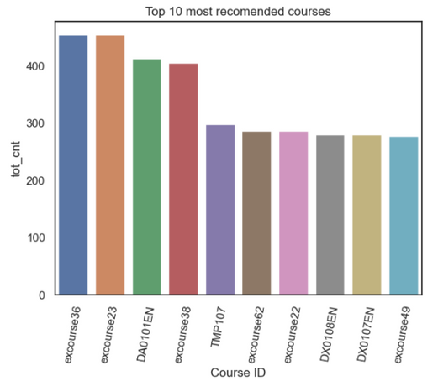
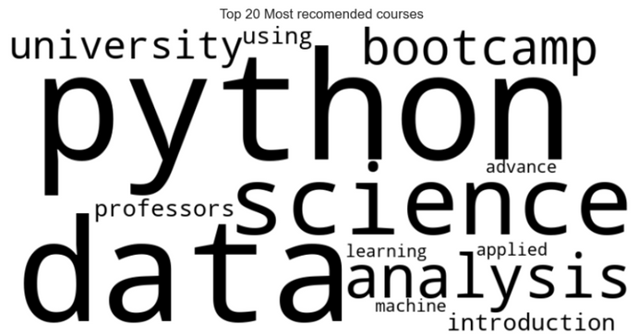
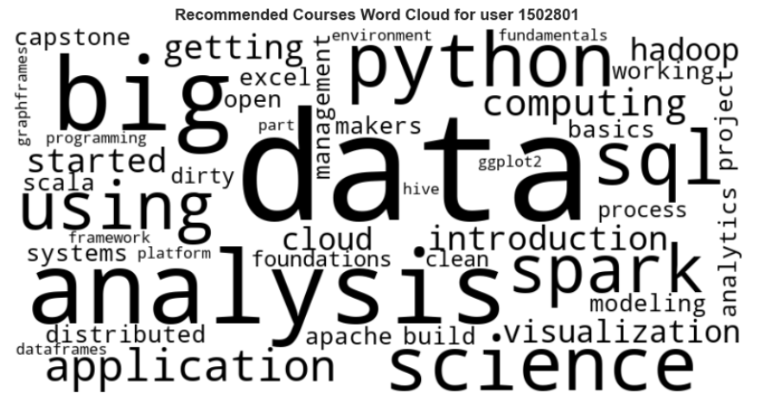
EVALUATION RESULTS OF COURSE SIMILARITY-BASED RECOMMENDER SYSTEM
The threshold utilized for this recommendation system is 40
The average recommendation per user is 11 courses
The top 20 recommendations look predominantly toward basic learning
Sample recommendations made to user 1502801 is a bit different from overall recommendations
Notes:
For the recommendation system build by me I have used a threshold score of 40 and average recommendation per user is 11 courses,
Also looking into the top 10 most recommended courses I have also created a word cloud that tells use that most of the courses recommended are related to someone starting new
Also here I have looked into a word cloud for recommendation made to a particular user user id 1502801 to understand the different recommendation made by different algorithms.

Slide 14
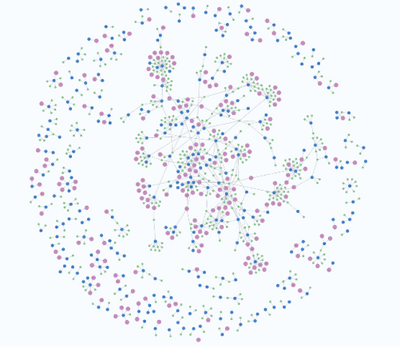
CONTENT-BASED RECOMENDER
Using clustering
Utilize the user profile vector by normalizing the genre rating for each specific vector
cluster the users using PCA and clustering algorithms
User test user rating data identify seen courses for each user and utilize cluster to identify unseen courses from all other users in that cluster
Determine popularity of unseen courses of the specific cluster user belongs to an rank courses based on popularity
Normalize the popularity scores to be between o and 100, this becomes our recomendation scores
2 datasets
Profile_genre - Userid, Genre Vector *
Test_user_rating - User_id, course_id, rating
Utilize a predefined score threshold to identify unseen courses to be recommended to the User
The threshold is selected based on course recommendation requirement **
Unseen Courses having Recommendation scores higher than the threshold are recommended to the user
RECOMENDATION SCORE
RECOMMEND COURSES
RAW DATA
DATA PROCESSING, CLEANING AND FEATURE ENGINEERING
THRESHOLD
Note:
*Genre Vector comprises all available course genres and have values marked only specific to each row
** Threshold score is selected based on requirements, a low threshold means more recommendations and a high would result in very few recommendations
Notes:
Raw Data:
Profile_genre: Contains user IDs and genre preferences of users.
test_user_ratings: User ratings for courses.
Data Preparation, Cleaning, and Feature Engineering:
Scale the user_profile_genre dataset to ensure consistent ranges of values.
Apply a clustering algorithm, such as K-means clustering. Consider using PCA to reduce dimensionality before clustering.
Determine the optimal number of clusters by analyzing divergence plots or other evaluation metrics.
Fit the clustering algorithm using the selected number of clusters.
Assign each user to a specific cluster based on their genre preferences.
Recommendation Score Calculation:
Identify the courses seen by each user based on their ratings in the user_rating dataset.
Determine the cluster to which the user belongs.
Find other users in the same cluster and analyze the courses they have interacted with.
Create a list of overall available courses by excluding the seen courses of the user.
Calculate the popularity score for each unseen course based on how many users have interacted with it.
Scale the popularity scores to a range of 0 to 100.
Threshold and Recommended Courses:
Set a predefined threshold to filter the courses to be recommended.
Recommend courses that have popularity scores higher than the threshold to the user.
Summary:
In this recommender system, clustering algorithms are utilized to group users based on their genre preferences.
The unseen courses are recommended based on their popularity scores, which are calculated by analyzing the interaction of users from the same cluster with those courses.
A threshold is applied to select the courses to be recommended to the user.
This approach helps in providing personalized recommendations by considering the preferences of users within the same cluster and suggesting popular courses based on their interests.

Slide 15
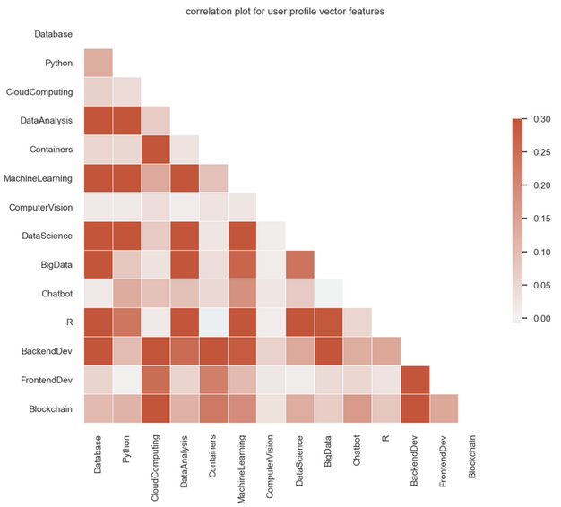
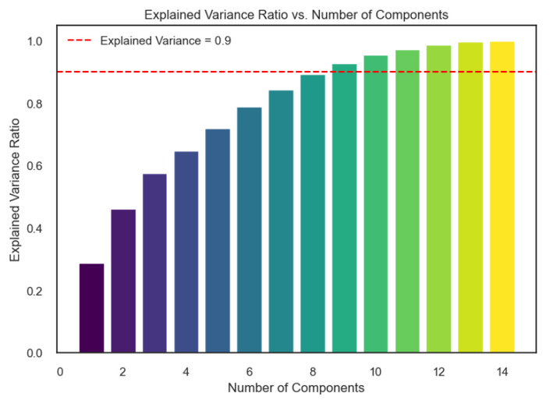
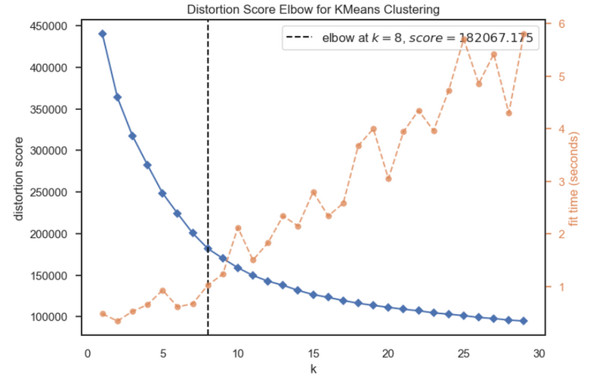
Visualization for clustering-based Recommender System

Slide 16
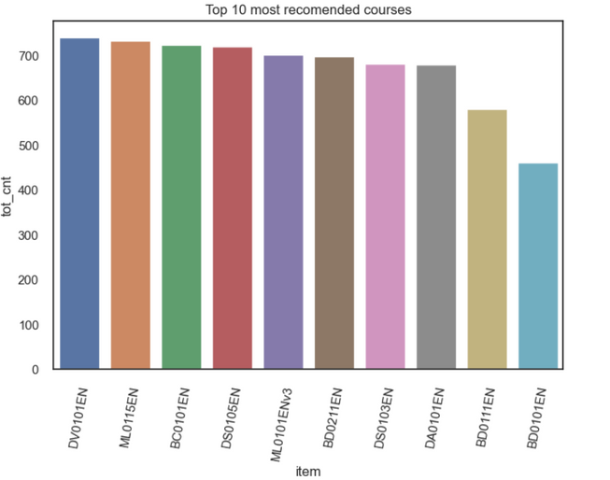
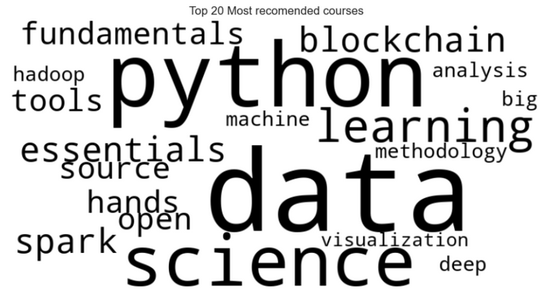
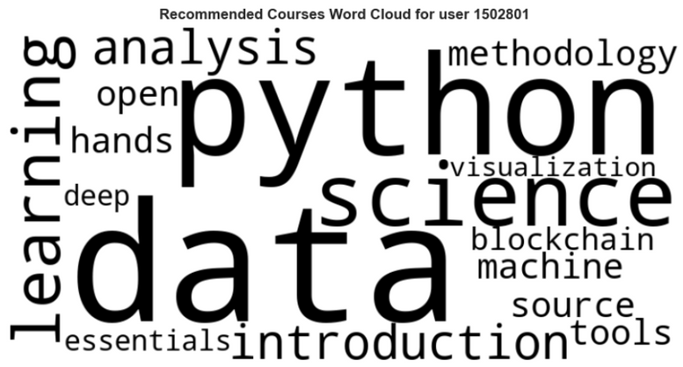
EVALUATION RESULTS OF COURSE SIMILARITY-BASED RECOMMENDER SYSTEM
The threshold utilized for this recommendation system is 40
The average recommendation per user is 9 courses
The top 20 recommendations look predominantly data science and machine learning
Sample recommendations made to user 1502801 are similar to overall recomendations

Slide 17
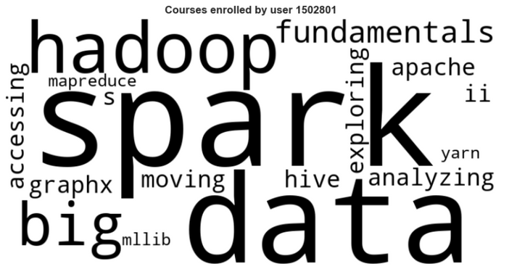
Performance Comparison of content based Algorithms Using Unsupervised Learning
The word cloud left here shows actual courses user 1502801 enrolled mainly hadoop spark etc
User profile recommendation suggesting more of the items the user has already seen big data, spark courses
Course similarity recommends a mix of big data, analysis, and data science
Clustering probably finds users similar to test users who are mostly interested in data science
Recommendation using user profile
Recommendation using Course Similarity
Recommendation using Clustering
Notes:
Summary of contest based recommendation
The word cloud left here shows actual courses user 1502801 enrolled mainly hadoop spark etc
User profile recommendation suggesting more of the items the user has already seen big data, spark courses
Course similarity recommends a mix of big data, analysis, and data science
Clustering probably finds users similar to test users who are mostly interested in data science

Slide 18
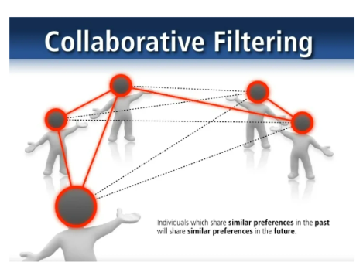
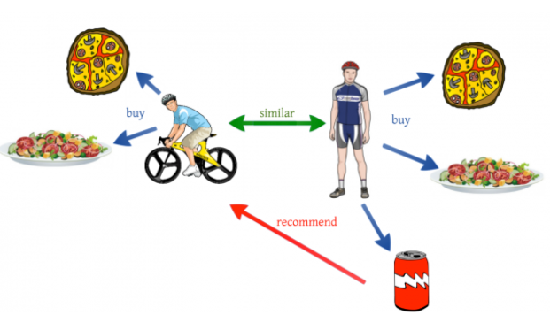
Collaborative-filtering Recommender System using Supervised Learning

Slide 19
COLLABORATIVE FILTERING-BASED RECOMENDER
Using KNN
fit KNN model using cosine similarity on the train data
Utilize the model to identify users similar to users in test data
get the rating for similar users and calculate the mean rating for each course as recommendation prediction
Utilize the dense user course rating matrix to create a sparse user-item interaction matrix
Each row corresponds to a specific user
Each column corresponds to a specific item/course
Split the data into train and test with 0.3 split ratio, use stratified sampling based on user
Based on predicted rating course are recomended to users
User_rating - User_id, course_id, rating
Utilize predicted rating and calculate RMSE using an actual rating from the test data to quantify model performance
RECOMENDATION SCORE
RECOMMEND COURSES
RAW DATA
DATA PROCESSING, CLEANING AND FEATURE ENGINEERING
EVALUATE PERFORMANCE
Notes:
Collaborative filtering is a widely used recommendation algorithm that can be implemented in different ways. In our project, we specifically focused on collaborative filtering using the K-nearest neighbors (KNN) algorithm. Here is a summary of the steps involved and the key information about collaborative filtering:
Data Preparation: We started with a user-course-rating dataframe, which represents the user-item interaction. This dense format was then converted into a sparse user-item interaction matrix using the pivot command in Pandas. To make the computations more manageable, we selected a subset of the data, including around 2,000 users and 104 courses.
Train-Test Split: The sparse matrix was divided into training and test data sets with a split ratio of 0.3. To ensure a fair evaluation, stratified sampling was performed to maintain an equal number of users in both sets.
KNN Model Training: Using the training data, we fit a KNN model. The goal is to find similar users based on their rating patterns. By calculating the similarities between user vectors in the interaction matrix, we identify the k nearest neighbors for each user. In our case, we set k to 5.
Prediction: With the KNN model trained, we can make predictions for the test data. For each user in the test set, we find their k nearest neighbors using the KNN model. Then, we aggregate the ratings of these neighbors to predict the ratings for the items that the user has not yet interacted with.
Evaluation: To assess the performance of our collaborative filtering model, we calculate the root mean square error (RMSE) for the predicted ratings compared to the actual ratings in the test data. In our project, the RMSE score was approximately 0.2381.
Collaborative filtering, specifically KNN-based, is a popular approach in recommendation systems. By leveraging the preferences and behaviors of similar users, it provides personalized recommendations. The user-item interaction matrix serves as the foundation for identifying similar users or items, and the KNN algorithm allows us to make predictions based on the ratings of those neighbors.
By summarizing the key steps and outcomes of our collaborative filtering using KNN, we can highlight the effectiveness of this approach in generating recommendations based on user-item interactions.

Slide 20
COLLABORATIVE FILTERING-BASED RECOMENDER
Using Non Matrix Factorization
Utilize the dense user course rating matrix to create a sparse user-item interaction matrix
Each row corresponds to a specific user
Each column corresponds to a specific item/course
Split the data into train and test with 0.3 split ratio, use stratified sampling based on user
Utilize NMF to factorize sparse matrix into user factors and item factors n_comonents set to 9
Calculate the ratings or predictions by multiplying user and item factors
Based on predicted rating course are recomended to users
User_rating - User_id, course_id, rating
Utilize predicted rating and calculate RMSE using an actual rating from the test data to quantify model performance
RECOMENDATION SCORE
RECOMMEND COURSES
RAW DATA
DATA PROCESSING, CLEANING AND FEATURE ENGINEERING
EVALUATE PERFORMANCE
Notes:
Raw Data: The input data consists of a dataframe called user_ratings_df, which is in a dense format, representing the user-item interactions. Each row corresponds to a specific user, and each column represents different items (courses). The cells contain the ratings given by users for the corresponding items.
Data Processing, Cleaning, and Feature Engineering: To apply NMF, we need to convert the dense dataframe into a sparse matrix format. The sparse matrix will have each row representing a user, and each column representing a course. The values in the matrix will be the ratings given by users for the respective courses.
Train-Test Split: Once we have the sparse matrix, we split the data into training and test sets. This is typically done to evaluate the performance of the recommendation model. A common split ratio is 70-30 or 80-20, where a certain percentage of the data is used for training the model, and the remaining portion is kept for testing.
NMF for Rating Predictions: With the training data, we apply NMF to factorize the sparse matrix into two lower-rank matrices: user factors and item factors. The number of factors determines the latent dimensions in which the user-item interactions are represented. NMF aims to find these factors that best approximate the original matrix by minimizing the reconstruction error.
Recommendation Score/Prediction: After obtaining the user and item factors, we can calculate the rating predictions for the test data. This is done by multiplying the user factors with the item factors to reconstruct the ratings matrix. The predicted ratings represent the likelihood of a user liking or interacting with a particular course.
Model Performance: To evaluate the performance of the NMF model, we calculate the Root Mean Square Error (RMSE) between the predicted ratings and the actual ratings in the test set. The lower the RMSE, the better the model's accuracy in predicting the user-item interactions. We got an RMSE OF 0.2577
Final Recommendation: Based on the predicted ratings, we can recommend courses to test users. The courses with the highest predicted ratings, indicating a higher likelihood of user interest, can be suggested as recommendations.
By following these steps, we can utilize Non-Negative Matrix Factorization to make predictions for recommending courses to test users. NMF helps uncover latent patterns and preferences in the user-item interactions, allowing for personalized recommendations based on these discovered factors.

Slide 21
COLLABORATIVE FILTERING-BASED RECOMENDER
Using Artificial Neural Network
Utilize the dense user course rating matrix to create a sparse user-item interaction matrix
Convert actual user ids and courses to integer indices for TensorFlow
Scale the data so that the values are between 0 and 1
Split the data into train and test with 0.3 split ratio, use stratified sampling based on user
Utilize neural network to create an architecture of user embedding layer (16) and user bias and courses embedding layer (16) and courses bias and Dense layers of 16 and 32 nodes
Make predictions for the ratings to each courses using the test users
Based on predicted rating course are recomended to users
User_rating - User_id, course_id, rating
Utilize predicted rating and calculate RMSE using an actual rating from the test data to quantify model performance
RECOMENDATION SCORE
RECOMMEND COURSES
RAW DATA
DATA PROCESSING, CLEANING AND FEATURE ENGINEERING
EVALUATE PERFORMANCE
Notes:
Raw Data: The raw data consists of a dense user rating matrix representing user-item interactions.
Data Preprocessing: The dense user rating matrix is transformed into a sparse user-item interaction matrix. User IDs and course IDs are converted to integer indices for embedding in the neural network. The rating values are scaled between 0 and 1. The data is then split into training and testing sets using a 0.3 split ratio with stratified sampling based on users.
Recommendation Score: Two different neural network models are trained. The first model is a simpler model with item and user embedding layers of size 16, along with item and user bias terms. L2 regularization and He normal embedding initializer are utilized. The second model includes additional dense layers of size 32 and 16 along with the embedding layers.
Prediction and Evaluation: The trained models are used to predict ratings for the test users. The performance of the models is evaluated using the Root Mean Square Error (RMSE). The simpler model achieves a validation RMSE of 0.1063, while the denser model achieves a validation RMSE of 0.1150.
Recommendation: Based on the predictions of the models, courses are recommended to the users. The recommended courses are determined by the highest predicted ratings, indicating a higher likelihood of user interest.
By utilizing artificial neural networks and collaborative filtering techniques, personalized course recommendations can be made to users based on their historical interactions. The models are trained to learn latent patterns and preferences from the user-item interactions, providing tailored recommendations to enhance the user experience.

Slide 22
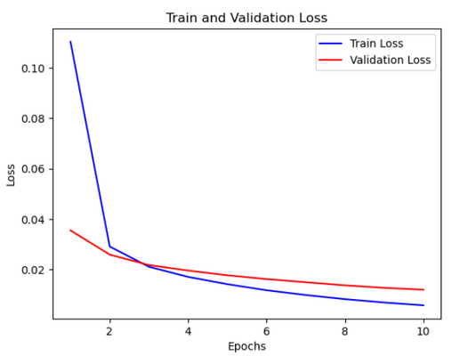
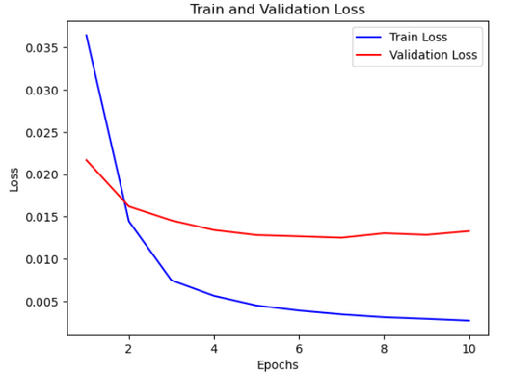
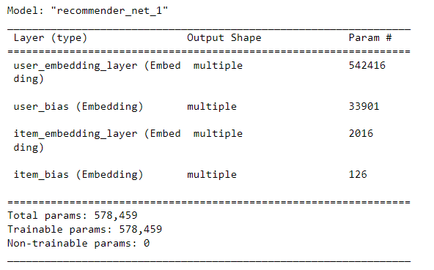
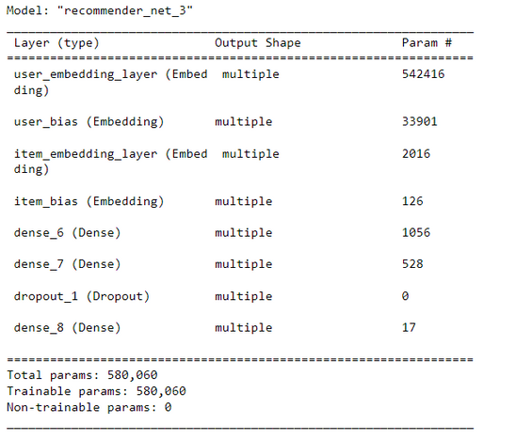
Summary of multiple ANN-based collaborative filtering recommendation systems
Validation RMSE - 0.1063
Validation RMSE - 0.1150

Slide 23
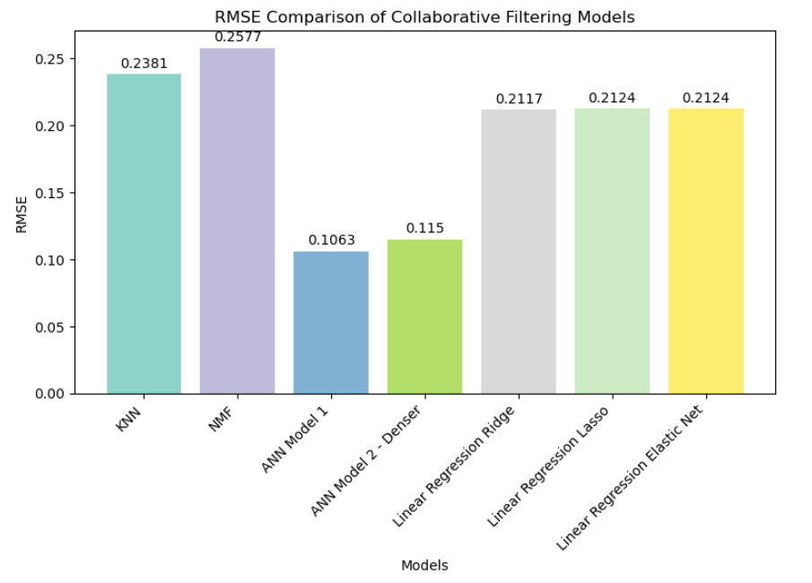
Performance Comparison of Recommendation Algorithms Using collaborative filtering
Amongst the linear regression models, all of them performed similarly to each other
Overall ANN performed the best

Slide 24
CONCLUSION
Recommendation engines enhance the user experience by providing personalized suggestions tailored to individual preferences and interests
The project focuses on building a recommendation engine for a Coursera lab using course and rating data
Challenges addressed include course discovery and information overload, which can be overcome with well-designed recommendation engines
The hypothesis is that implementing various recommendation techniques can significantly improve course discovery and enhance user satisfaction
EDA reveals popular IT-related keywords in course titles, indicating a focus on demanding IT skills
Enrollment analysis shows varying levels of course engagement among users, with some exploring multiple courses and others focusing on a single course
Content-based recommender uses user-profiles and course genres to provide personalized recommendations aligned with user interests
Collaborative filtering with KNN algorithm involves data preparation, model training, prediction, and evaluation using RMSE
The analysis and results highlight the effectiveness of different recommendation techniques in enhancing user satisfaction.

Slide 25
APPENDIX
Utilized Coursera labs and instructions: The project utilized Coursera labs and instructions as a primary resource for understanding and implementing recommendation engine techniques.
Leveraged sample code from Stack Overflow: Stack Overflow served as a valuable resource for finding sample code and solutions to specific programming challenges encountered during the project.

